Slide 1
Predicting the Best Location To Start A Business In Toronto, Canada

Slide 2
The main premise of our research paper will center on investigating and determining the ideal locale in Toronto, Canada, for the establishment of a new dining experience, a restaurant targeting people whose taste palette is unconventional and outside the box.
Toronto is Canada’s business and financial capital, a growing financial hub in North America, and a top ten global financial centre. The Toronto region’s GDP accounts for 18 per cent of Canada’s GDP and Toronto’s economy grew by 2.4 per cent in 2014.
So it is really beneficial for us to work on getting a house in good locality and neighborhood.

Slide 3
Data Sourcing, Cleaning and Wrangling
Data is messy and never comes ready and prepped to use, and so, much tweaking, messing and munging took place with the data used in the report.
Initially, I obtained demographic and household data on Toronto and its environments from the parsing the 2016 Canadian census.
In Toronto's 2016 Census that contains Population, Average income per Neighborhood with Toronto’s Neighborhoods shapefile and Foursquare API to collect competitors on the same neighborhoods.
Toronto’s census data is available at this website: https://www.toronto.ca/city-government/data-research-maps/open-data/open-data-catalogue/#8c732154-5012-9afe-d0cd-ba3ffc813d5a
And:
https://en.wikipedia.org/wiki/List_of_postal_codes_of_Canada:_M

Slide 4
For this report I used a few different maps that could help a new investor to decide the best neighborhood to open a restaurant in Toronto based on its income, population and available competitors. In order to do that I've used the 2016 Census information combined with maps, tables and graphs to visually display the wealthier and more populational neighborhoods and Foursquare data to display the current restaurants in each region.
Toronto Neighborhoods' shapefile is publicly available at this :
website: https://www.toronto.ca/city-government/data-research-maps/open-data/open- data-catalogue/#a45bd45a-ede8-730e-1abc-93105b2c439f

Slide 5
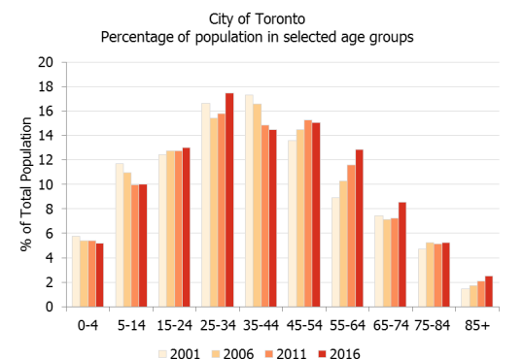
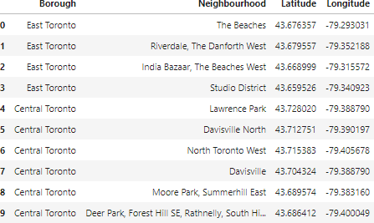

Slide 6
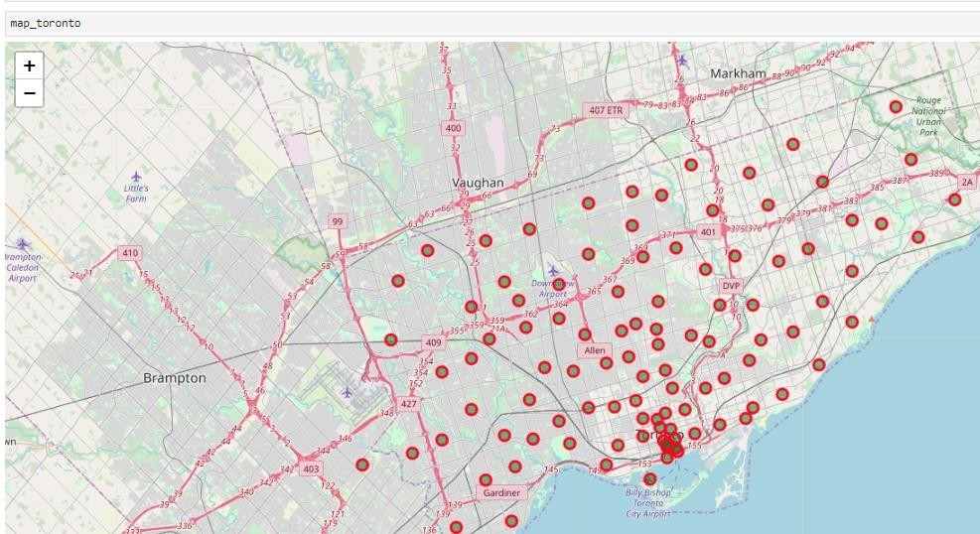
This problem is best suited for a classification methodology as opposed to a regression. Therefore, I employ the popular, somewhat simpler relative to other ML models available, but efficient and power, K-means Clustering in Python
K-means clustering is a clustering algorithm that aims to partition nn observations into kk clusters. Primarily, there are 3 key steps to executing a k-means method, that is: Initialization – K initial “means” (centroids) are generated at random; next Assignment – K clusters are created by associating each observation with the nearest centroid, and finally Update – The centroid of the clusters becomes the new mean Assignment. This process continues, and Update are repeated iteratively until convergence

Slide 7
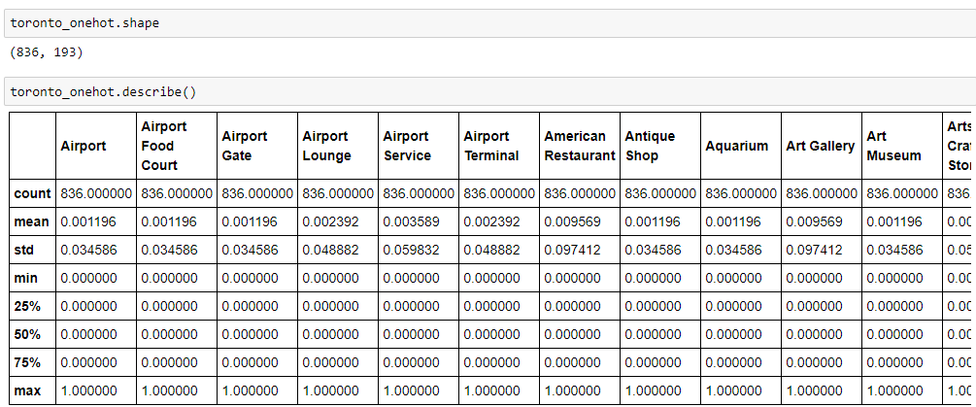
Results:
Comparing the maps, we can notice many of the restaurants grouped on main streets and on the south of the city, although some of the wealthiest neighborhoods are up to the north. Also, the areas with a dense population don't reflect on the number of restaurants.

Slide 8
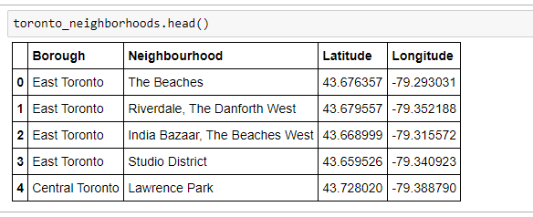
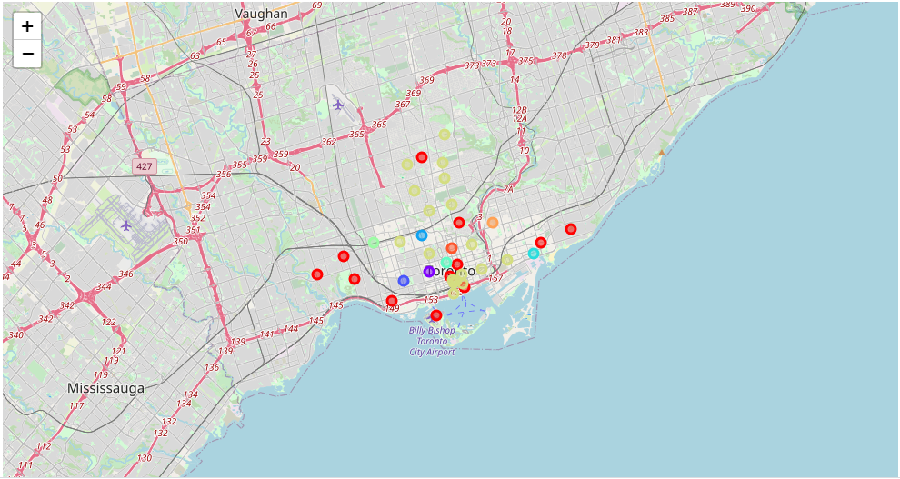
The illustration below shows the final neighborhood cluster, East Toronto, in yellow as the best location:

Slide 9
Discussion:
This presentation may be helpful for someone planning on opening a restaurant in Toronto, as any similar such type of business. They can be confident that by comparing the current offers and neighborhoods profiles, however it may not cover all variables such as access to public transportation or even the restaurants profiles, so it shall not be used as a single decision-making tool. Reports of this nature have a shelf life and one should always appreciate and contextualize their process going forward. However, I have no doubt that businesses will be aware of all these factors.

Slide 10
Conclusion:
After examining the above 5 clusters, I believe and would recommend that cluster label (7), East Toronto is the best Neighborhood to set up shop for a new business venture. While there are great locations like downtown, Lawrence Park and Riverdale, East Toronto presents the best opportunity to be a first mover as well an early entrant into a community that is poised to experience phenomenal growth. East Toronto is the most suitable locale as it has an expanding population, colleges, a dependable public transport system, supporting entities for the productive population a business will need and attract.

